Slide 1
OpenShift Hybrid Windows and Linux
Glenn West, Principle Engineer
Version 1 – April 23 2018

Slide 2
Challenges/Questions
How to deploy Windows nodes in a OpenShift Cluster?
What is needed to do this?
How to make it Simple.
Is the Microsoft Doc good enough?
What are the issues?

Slide 3
Infrastructure
Cluster Deployed Directly On Azure
3 Masters – 3 Infrastructure VM’s – 1 Rhel Node – 2 Windows Node
Standard Windows 2016 Datacenter Server Edition (No Patches)
RHEL 7.4 with latest patches (Auto Applied)

Slide 4
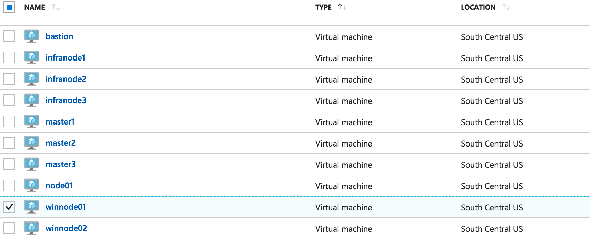
Azure Portal of OCP Hybrid Cluster

Slide 5
Software Components
A Bash script to deploy a cluster.
A Container based repo for 3.9 puddles of ocp.
A ARM based(Azure Resoure Manager) script to deploy all virtual infrastructure on Azure including Linux and Windows nodes
A Bash/Ansible Script that fully installs ocp 3.9 HA cluster with AV Sets, Load Balancers, 1-32 linux compute,
A Separate Ansible script that installs 1-32 windows nodes
Simple script to tunnel to Windows nodes via bastion for RDP
Various Powershell scripts

Slide 6
Interesting Parts
No Code Changes to OpenShift
No Code Changes in Openshift Ansible Installer
No Special Version of OCP 3.9 – Standard Puddle – Expect GA Bits to be fine
Few additional RPM’s to support Ansible to Windows nodes
Just add rdp client to work on windows nodes via ssh to bastion host
Existing security and firewall all match existing ref arch best practice
Begin to end of deploy estimate 45 minutes for full HA multi-node cluster

Slide 7
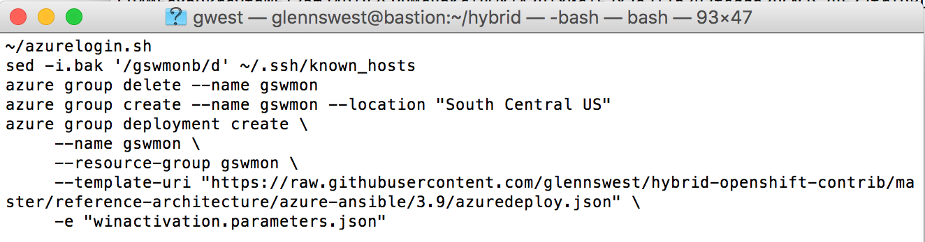
How hard is it to repeat
Need a proper Azure account with good resources available
Mark Heslin controls this access
Run a simple script (Assuming the Azure CLI Is installed)
Forked from 3.6/3.7 Ref arch – Formal doc and theory is same

Slide 8
Walk thru of changes - Baseline
Forked Azure ref arch from existing 3.7 work (Official)
Removed all unrelated files/sub projects
Did a container based repo of puddles using Nginx for 3.9 OCP
Upgraded the exisitng ref arch to handle 3.9 differences.
Added new varibles to ref arch to support Windows Node Count
Added new sub-arm script for windows node deployment
Debugged 3.9 setup and make sure cluster comes up

Slide 9
Windows Specific using Ansible – Part 1
Added a new ansible group for Windows
Added ansible config file (Group-vars) to allow ansible to control windows nodes
Developed a new Ansible Script to Setup the Windows Nodes
Original Microsoft uses a bootstrap token, we use a pre-generation of all certs/config files instead. The bootstrap token is not recommended even upstream till 3.10 at soonest, tbd on ocp
Implemented the pre-generation and deployment of configs and nodes

Slide 10
Windows Specific using Ansible – Part 2
Install Kubernetes on windows - No Package management ☹
No ETC – So create directory structure (c:\k) and setup enviornment variables (Powershell in ansible)
Download and install cni – No Package Management ☹
Donwload and install windows package manager
Download and install git
Gnerate OCP Config files on Master
Pull configs to bastion
Push config to each Node
Start Kublet on Windows (Currently done manually)

Slide 11
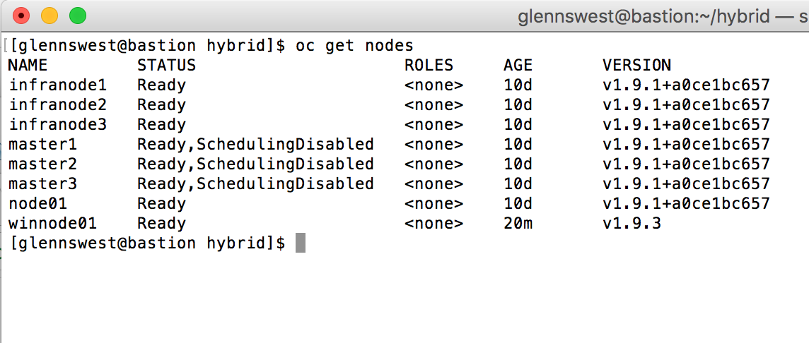
Objectives Accomplished
Allow fully automated – repeatable install of Linux and Windows VM ready for OCP
Installs OCP 3.9 puddles using a local container based repo on the bastion (No breaks)
Windows nodes part of OCP (Kubernetes is installed enough to function and report to Cluster and stays up

Slide 12
To Be done:
1 Day – Make sure everything has been captured and is repeatable
2 Days +/- Add Networking Setup and Validation
1 Day +/- Applciation Validation
Demo Day (This slide deck will expand)

Slide 13
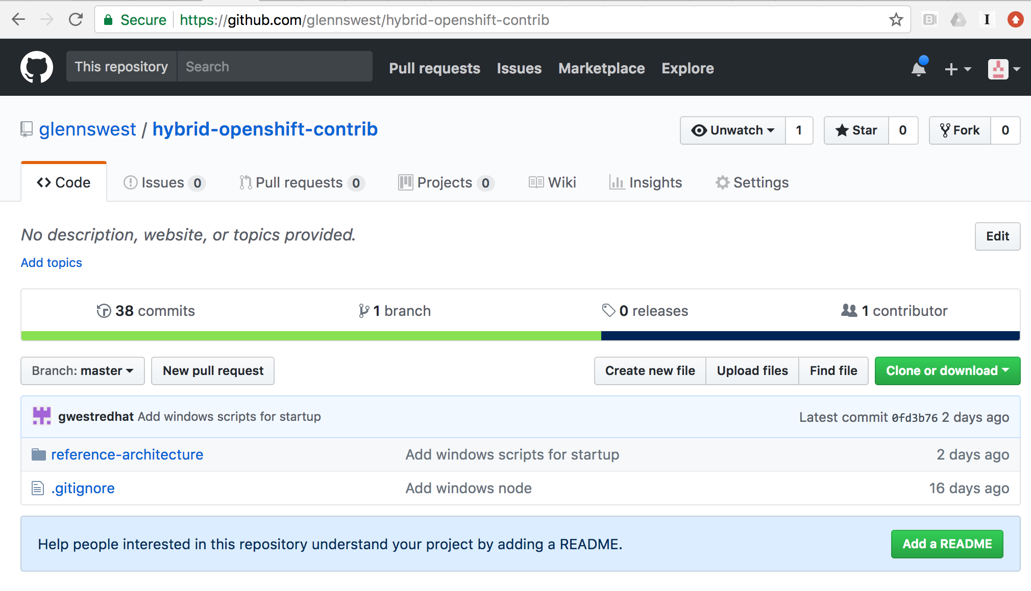
OCP Hybrid Repo (ARM/Bash/Ansible)

Slide 14
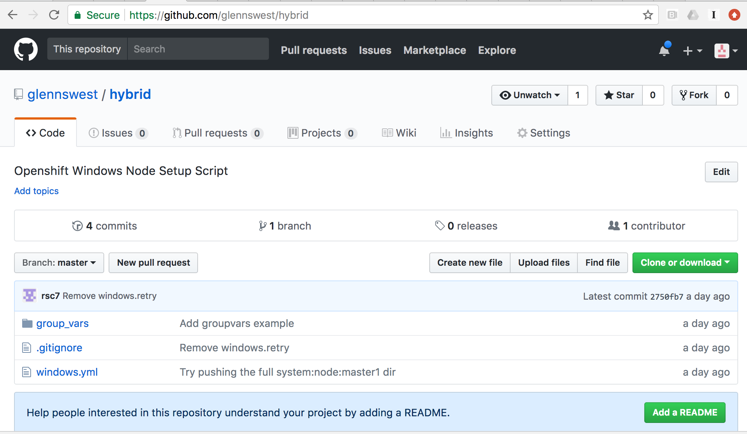
Hybrid Script – Windows Node Setup

Slide 15
Findings
Microsoft Doc is not usable by typical RedHatter or Customer (Even advanced
The bootstrap token / certs alone invalidates the Document
The lack of package management is really lacking in polish
Consider RedHat Packaging into Chocolaty to get consistant Windows nodes working with OCP
Recommend we take the “Hybrid” script functionality and build directy into Ansible Installer (Prepped for that)
Consider a “Ref Arch” for OCP Hybrid (Baiscally this work upgraded to GA/Tech Preview Bits and a fork of the Ref Arch Doc
Technology Side does appear to work – lots more testing is needed

Slide 16
Going Forward
Complete the networking and basic app test (It’s already in my trello card) – 5 days +/-
Checkout how Persistant Volumes work
Trial and Feed back this as a POC
Do the DOC and productise the bits/package to Tech Preview Status
Test it and Push it to Supportable
Consider supporting multiple network types (Quite a few coming)
Consider multiple cloud providers (Beyond Azure)

